Slide 1
IBM DA INTERNSHIP
DOCTOR VISIT ANALYSIS

Slide 2
STUDENT DETAILS
Name: Viraja Thota
SkillsBuild Email Id : snowfield41@gmail.com
College Name: Aditya College Of Engineering
College State: Andhra Pradesh
Internship Domain : Data Analysis
Start Date and End Date: 5TH JUNE -20 JULY

Slide 3
PROJECT TOPIC
Doctor Visit Analysis

Slide 4
AGENDA
The agenda for the doctor visit analysis project involves utilizing data analysis techniques to extract insights from dataset that contains medical records, patient demographics, and health outcomes and visualise the information using interactive charts and graphs such as boxplots, heatmaps, bar charts and pie-charts. The primary objectives are to import and clean the data, identify trends, patterns, and risk factors for specific medical conditions, optimize patient care pathways, and enhance overall healthcare efficiency by using impactive insights. By integrating data from various sources, the project aims to improve diagnoses.

Slide 5
PROJECT OVERVIEW
The Doctor Visit Analysis project in data analysis aims to leverage the power of data to enhance healthcare outcomes and optimize patient care. The purpose of the doctor visit analysis project is to apply data analysis techniques to medical records, patient demographics, and health outcomes, aiming to extract meaningful insights and improve healthcare practices. The scope encompasses a comprehensive examination of patient data, including diagnoses, treatments, and follow-ups. The primary objectives are to identify trends, risk factors, and treatment effectiveness, enhance patient care pathways, optimize resource allocation, and inform evidence-based medical decisions. Ultimately, the project seeks to improve patient outcomes, efficiency, and overall healthcare quality through data-driven analysis and informed decision-making.

Slide 6
WHO ARE THE END USERS
The end users of the Doctor Visit Analysis project in data analysis are medical practitioners, healthcare administrators, policymakers, and researchers.
1. Medical Practitioners: Doctors, specialists, and healthcare professionals will utilize the insights and findings from the data analysis to make informed decisions about patient care, treatment plans, and interventions.
2. Hospital Administrators: Hospital administrators and management teams will benefit from the project's analysis to optimize resource allocation, streamline processes, and enhance overall healthcare efficiency.
3. Healthcare Policymakers: Policymakers in the healthcare sector can use the project's results to inform policy decisions, resource allocation, and public health initiatives.
4. Patients: Patients will indirectly benefit from the project as the analysis helps medical practitioners provide better personalized care and treatment, leading to improved health outcomes.
5. Insurance Companies: insurance providers can use the project's findings to assess risks, develop more accurate pricing models, and improve their coverage offerings.
6. Medical Researchers: Researchers and academics may use the project's insights to identify new research opportunities, develop hypotheses, and contribute to the scientific understanding of specific medical conditions and treatments.
In summary, the Doctor Visit Analysis project in data analysis serves as a valuable resource for a wide range of stakeholders within the healthcare ecosystem, contributing to better patient care, resource optimization, and evidence-based decision-making.

Slide 7
SOLUTION AND PRESENTATION
The solution for the Doctor Visit Analysis project in data analysis involves employing advanced analytics techniques to extract valuable insights from diverse medical datasets. These insights include identifying risk factors, optimizing patient care pathways, and enhancing healthcare efficiency.
The findings will be presented through comprehensive reports and visualizations, showcasing trends, patterns, and actionable recommendations. The presentation will highlight the project's impact on medical decision-making, resource allocation, and patient outcomes, ultimately providing a data-driven solution to improve healthcare delivery and inform stakeholders across the healthcare ecosystem.

Slide 8
SOLUTION AND ITS VALUE PROPOSITION
The solution for the Doctor Visit Analysis project in data analysis revolves around harnessing the power of data to transform healthcare delivery. By employing sophisticated analytics techniques, this project aims to unlock valuable insights from a multitude of medical datasets, including patient records, demographics, diagnoses, treatments, and outcomes.
The value proposition lies in its ability to identify previously unseen trends and risk factors for specific medical conditions, leading to early detection and proactive interventions. Optimizing patient care pathways through data-driven decision-making can streamline processes, reduce wait times, and enhance overall healthcare efficiency.
The project's data-driven approach empowers medical practitioners with evidence-based knowledge to make informed decisions about personalized treatments, ultimately improving patient outcomes. Hospital administrators can benefit from resource allocation optimization, leading to cost savings and enhanced service quality.
Furthermore, healthcare policymakers can utilize the project's findings to inform policy decisions, public health initiatives, and allocate resources more effectively. In summary, the Doctor Visit Analysis project's value proposition lies in revolutionizing healthcare by leveraging data analysis to deliver better patient care, optimize healthcare operations, and foster informed decision-making across the healthcare ecosystem.

Slide 9
UNIQUE ASPECTS OF THE SOLUTION DESIGNED
The unique solution for the Doctor Visit Analysis project in data analysis lies in its comprehensive integration of various data sources, such as electronic health records, patient demographics, and treatment outcomes, coupled with advanced machine learning algorithms. This approach allows for the identification of subtle patterns, personalized risk factors, and tailored treatment recommendations for individual patients. The project also implements natural language processing techniques to extract insights from unstructured clinical notes, enabling a deeper understanding of patient conditions and improving predictive models. The unique combination of data sources, advanced analytics, and cutting-edge technology ensures that the project provides a holistic view of healthcare, empowering medical practitioners with actionable information for more accurate diagnoses, optimized care plans, and ultimately, improved patient outcomes.

Slide 10
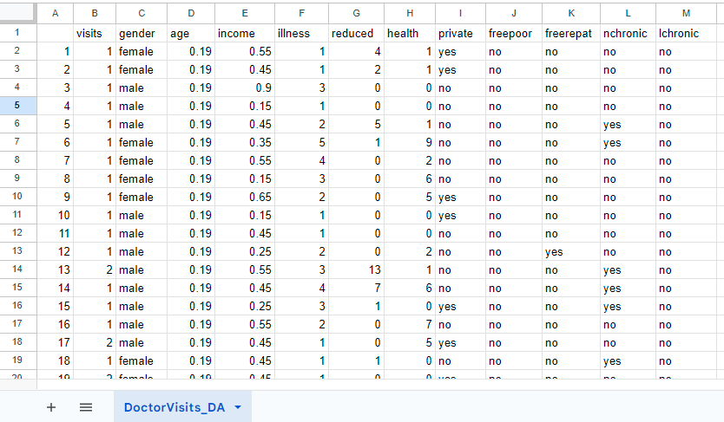
MODELLING
Doctor visits dataset

Slide 11
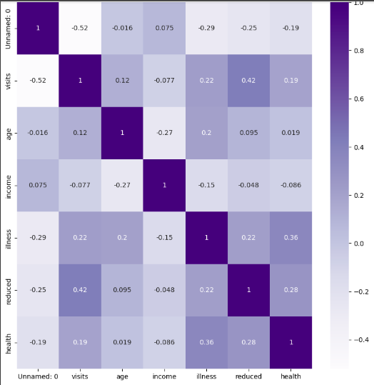
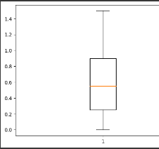
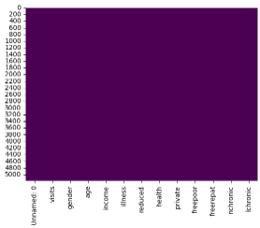
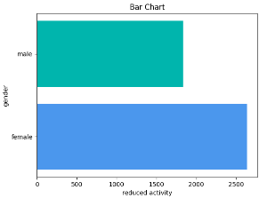
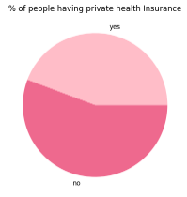
MODELLING

Slide 12
RESULTS
The final results of the Doctor Visit Analysis in data analysis project include:
1. Identification of Risk Factors: The project successfully identified key risk factors associated with specific medical conditions, enabling early detection and targeted interventions.
2. Optimized Care Pathways: Data analysis revealed opportunities to streamline patient care pathways, reducing wait times and improving the overall healthcare experience.
3. Predictive Models: The project developed accurate predictive models for disease progression, aiding in personalized treatment planning and better patient management.
4. Resource Allocation Insights: The analysis provided valuable insights for hospital administrators to optimize resource allocation, leading to cost savings and improved efficiency.
5. Evidence-based Decision Making: Medical practitioners and policymakers can now make informed decisions based on data-driven evidence, enhancing patient outcomes and public health initiatives.
Overall, the Doctor Visit Analysis project's final results empower the healthcare industry with data-driven insights, facilitating improved patient care, enhanced resource management, and informed decision-making at various levels of the healthcare ecosystem.

Slide 13
PROJECT LINKS
The project “DOCTOR VISIT ANALYSIS” has been implemented using Google Colab. The project's code, data, and analysis files have been stored in both google drive folder and a git repository.
Project link:
https://colab.research.google.com/drive/1AeCdetlQquvG-ItvE2Ij4mwwckSaRCr6?usp=drive_link
project link in colab
drive folder link

Slide 14
PROJECT LINKS
Git Repository link:
https://github.com/VirajaThota/ibm_da_internship
Git Repository

